Slide 1

Unsupervised Learning using K-means Clustering: Python Vs ArcGIS
Cristian Noriega Monsalve, Blessing Austin-Gabriel, Ernest Chianumba, Rolih Ferdinand

Slide 2
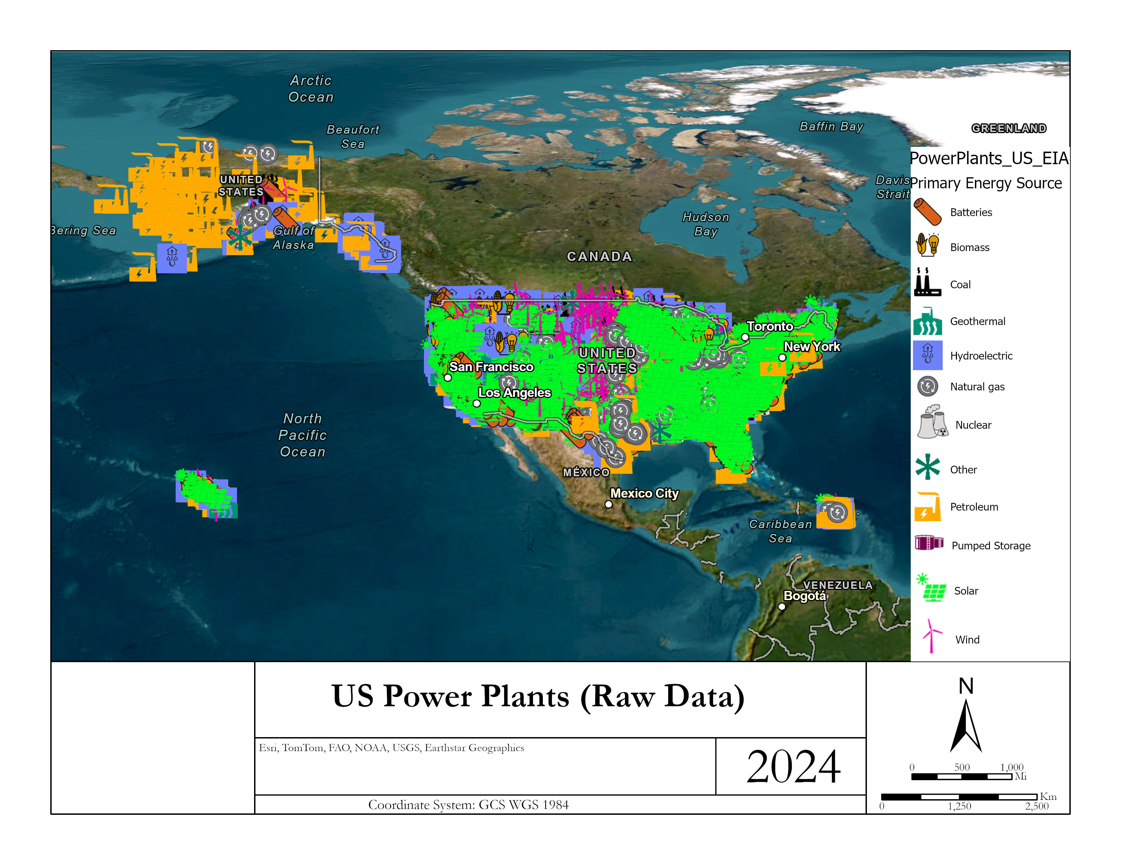
Data Set Visualization

Slide 3
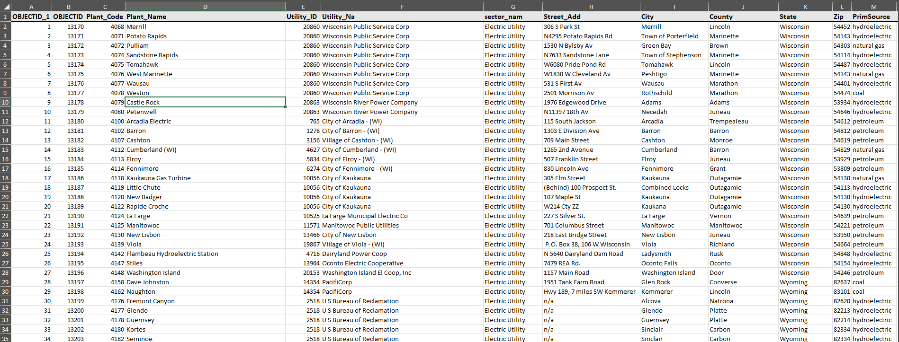
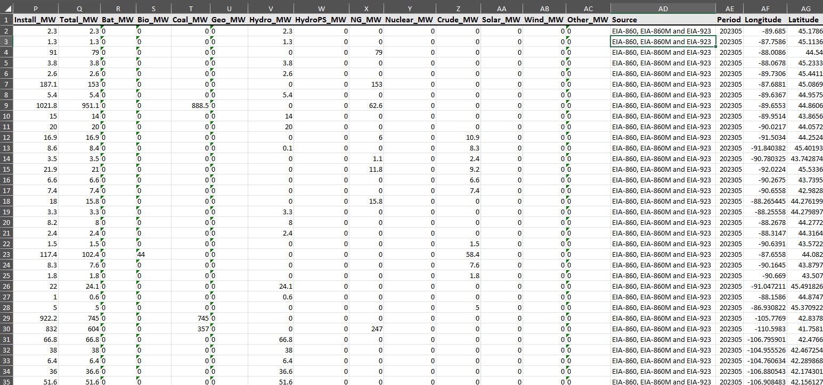
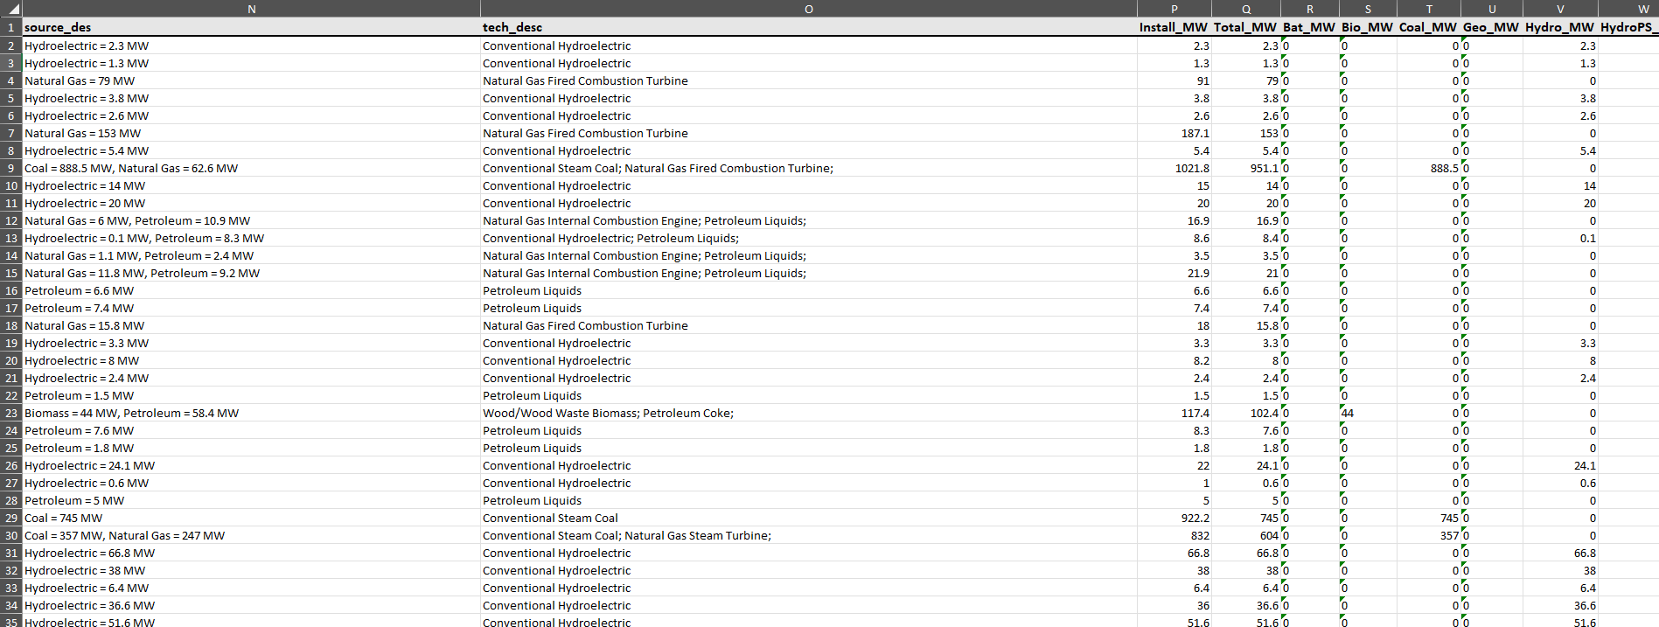
Data Set Description

Slide 4
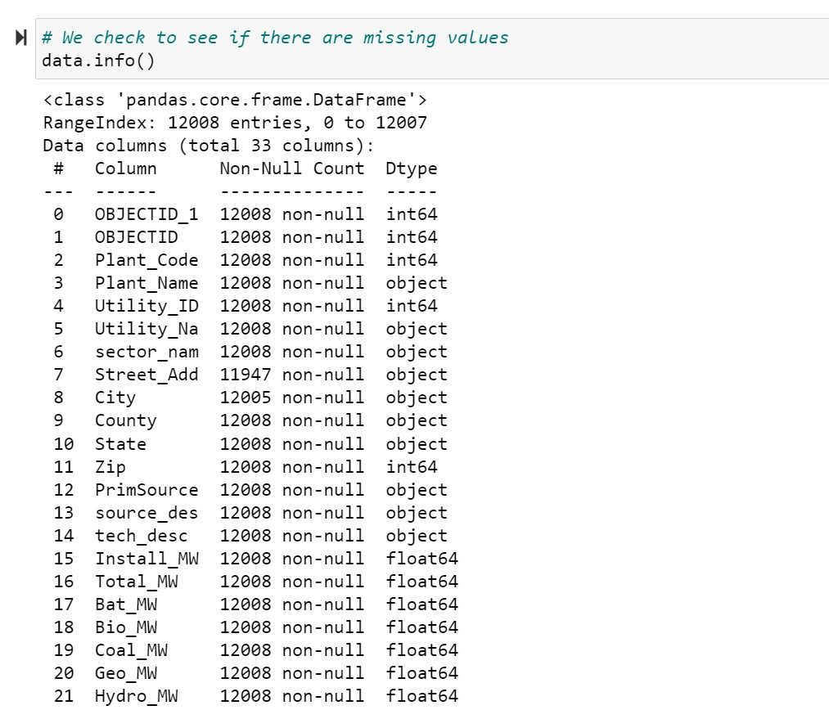
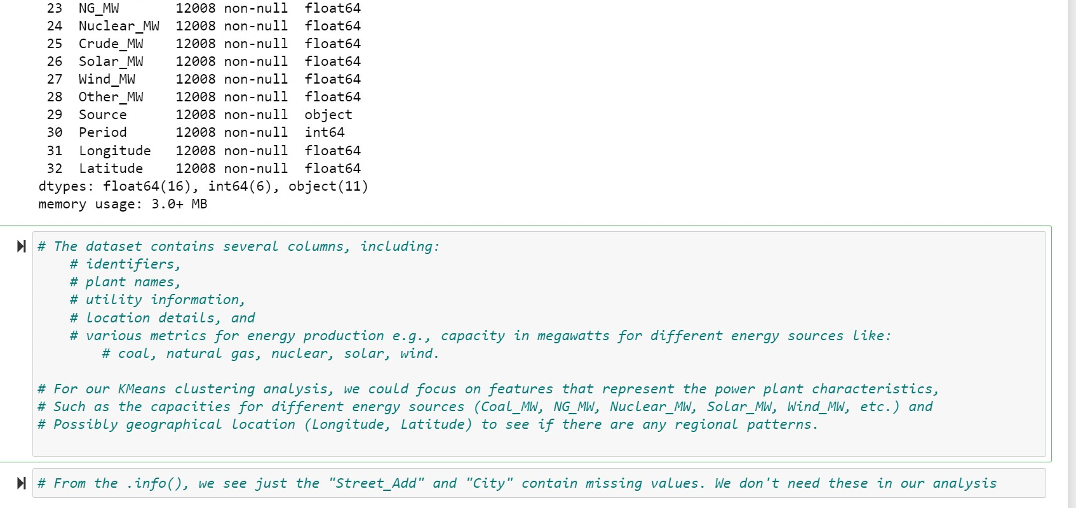
Data Set Description

Slide 5
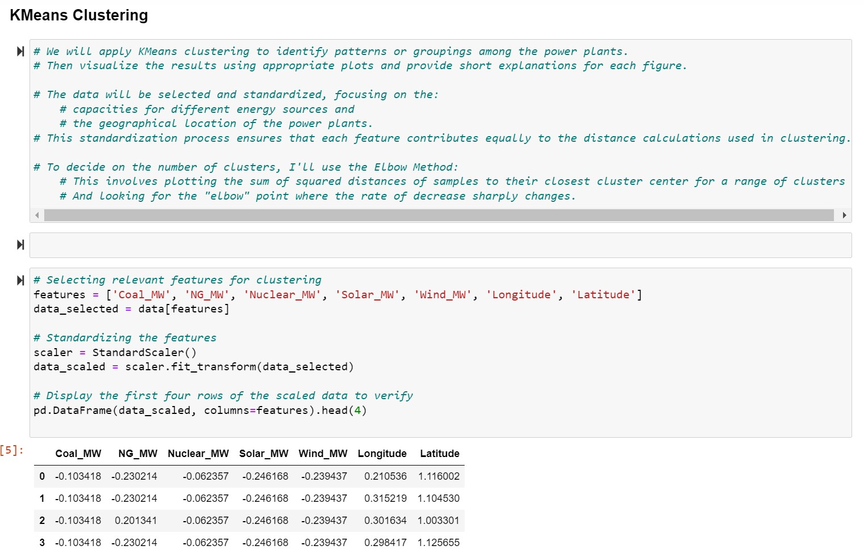
Preprocessing Techniques: Feature Selection & Standardization

Slide 6
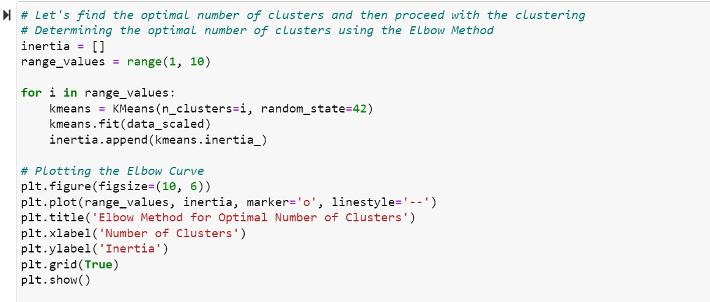
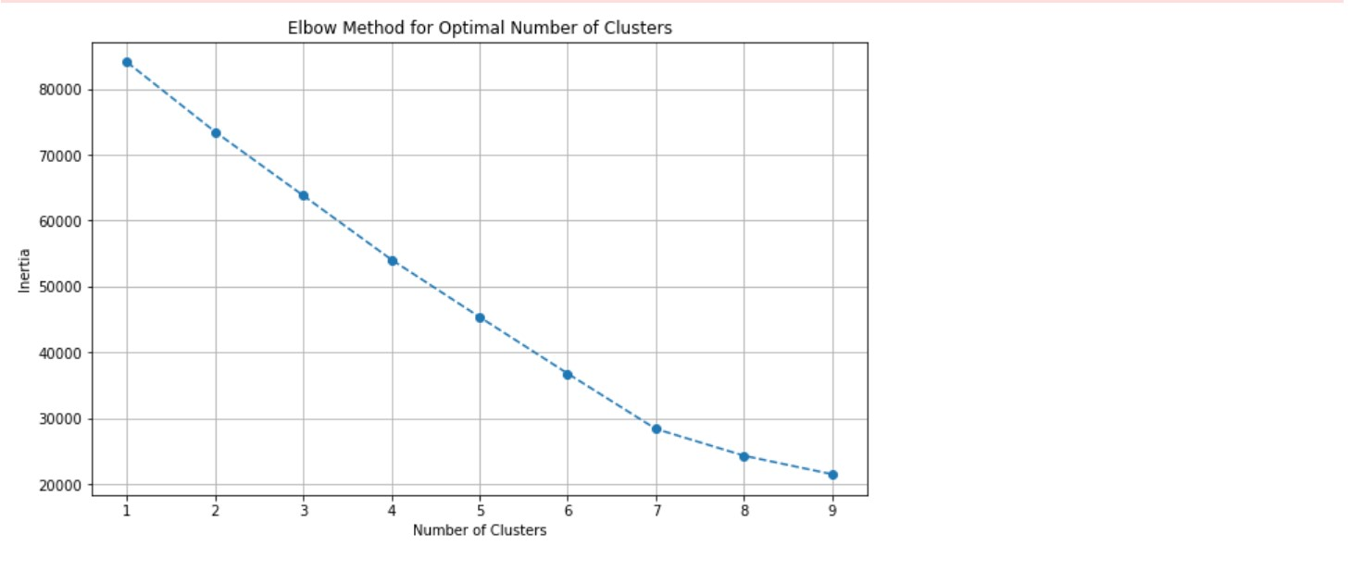
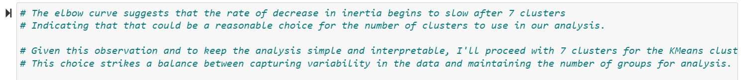
Machine Learning Technique: K-means Clustering

Slide 7
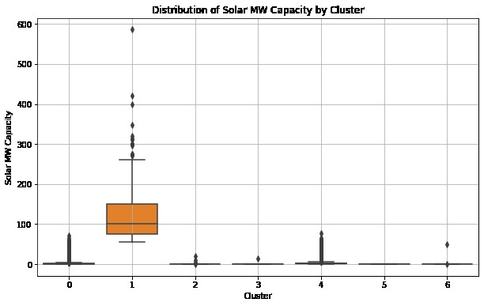
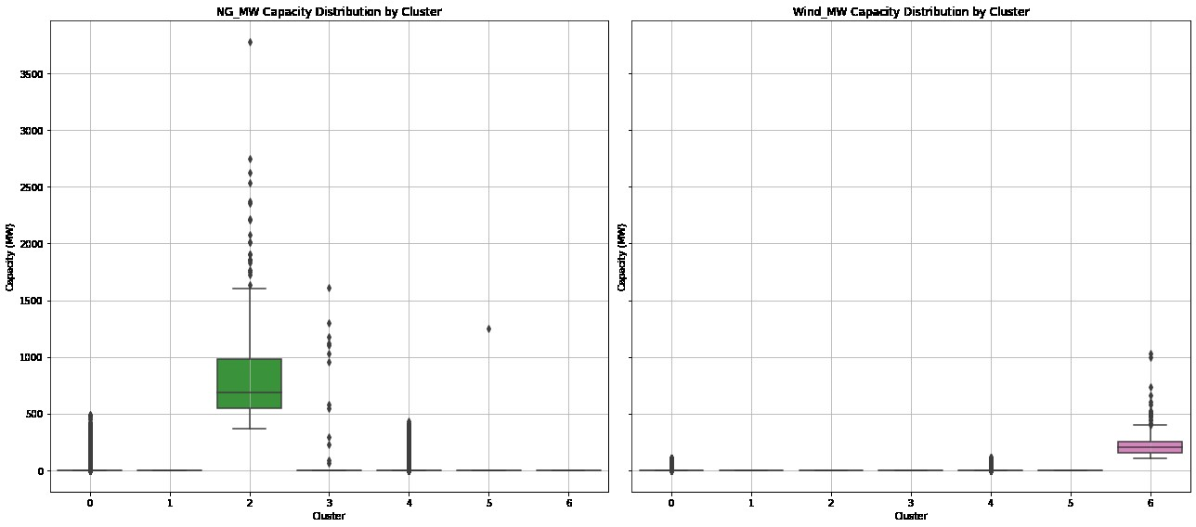
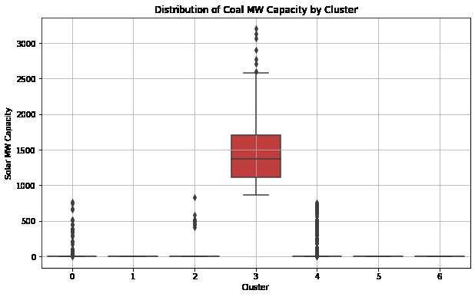
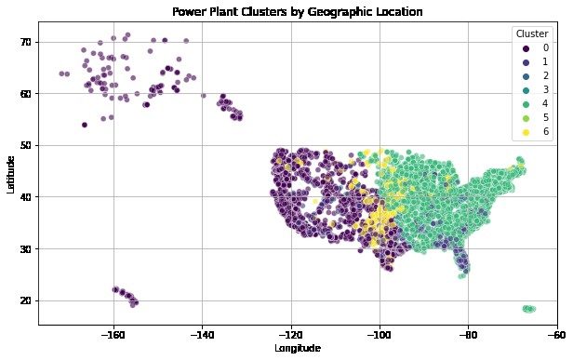
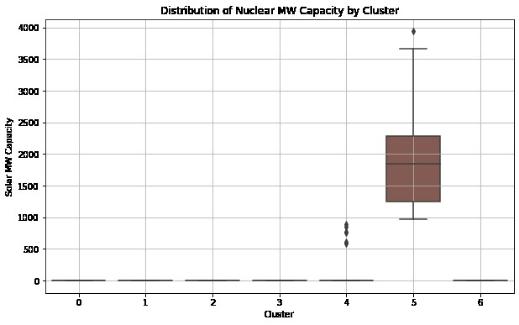
Python Results

Slide 8
Cluster Analysis Conclusion
These visualizations provided insights into:
How power plants are geographically grouped based on the energy source capacities and location.
The variability in power capacity among different clusters.
Potentially indicating specialization or focus on a particular energy source in certain regions or by certain types of power plants.
We learned that different techniques of preprocessing and selecting different features can perform different varieties of analyses, to yield different insights, especially depending on the type and variety of data that is collected.
Using power plants gives a wide range of initial attributes.

Slide 9
References
https://montclair.maps.arcgis.com/home/item.html?id=b063316fac7345dba4bae96eaa813b2f (US Power Plants Data source)
https://pro.arcgis.com/en/pro-app/latest/tool-reference/spatial-statistics/multivariate-clustering.htm (ArcGIS - Multivariate Clustering Tool)

